Slide 1

Easy payy – online recharge website
C-dac march - 2023

Slide 2
Agenda
Introduction
Project Architecture
Technologies Used
User Roles and Responsibilities
Project Interface
Technology Platform Used
Software Tools Used
Future Extensions
Conclusion

Slide 3
Introduction
Purpose of Online Easy Payy Reachrge Website
The primary purpose of developing a mobile recharge app is to provide users with a comprehensive and user-friendly platform for managing their mobile plans and recharges seamlessly. The app aims to address the inconvenience associated with traditional methods of mobile recharge, such as physical recharge cards or visiting retail outlets. By offering a variety of mobile prepaid plans from different telecom operators, the app caters to diverse user preferences and usage patterns. This variety ensures that users can easily find and customize plans that suit their specific needs.
Need of Online Easy Payy Reachrge Website
Creating an online recharge website offers significant advantages in the realm of software development. Such a platform provides users with the convenience of easily recharging mobile phones, paying bills, and managing various services online, reducing the need for physical visits. With a broad potential user base, integration of diverse payment methods, and the possibility of offering personalized promotions, the platform can cater to modern digital transaction trends.

Slide 4
Project architecture
Technologies Used:
Html , CSS , JSP
Bootstrap
JavaScript.
Front End Layer
Used for
Server Layer
Used for
Database Layer
Used for
User Interface
Basic data Validation
Server Side Validations, if needed
Response Handling
Business Logic
Database Operation
Permanent Data Storage
Database Level validations
Database Access using Stored Procedures
Technologies Used:
Spring
Hibernate
Technologies Used:
MySQL

Slide 5
Technology platforms used
1.Technologies Used:
Html
Css
BootStrap
JavaScript
Spring Framework
Hibernate
MySQL

Slide 6
Frontend Tier
This tier is used for user interface and it is also called as client tier.
In this tier we are using Html, Css and Javascript ,because it provides excellent cross-platform support.
The use of JavaScript facilities us for the client-side validation.
We have used Bootstrap for the presentation purpose.
2. Server Tier
Spring Framework makes it easy to create stand-alone, production-grade Spring based Applications. By Using embed Tomcat server into an application.
Hibernate is framework that provides tools for object relational mapping (ORM). The application uses the Hibernate framework as the persistence layer to retrieve POJOs (plain old Java objects) from a relational database.

Slide 7
3. Database Tier
Third tier consist of a Data Access Object (DAO) and the back end i.e. the database of system.
Application Properties file reduces the efforts of configuring JDBC with MySQL along with SQL dialect making Hibernate generate better SQL queries for the chosen database

Slide 8

SOFTWARE TOOLS USED
ECLIPSE
VS CODE
MYSQL
TOMCAT

Slide 9
2. FEATURES PROVIDED:
I.FOR ADMIN:-
Browse - Admin can browse the homepage to explore the entire welcome page.
Login & Logout – Similar to user, admins can login & logout to access their account.
Add offers –Only admin is responsible for adding the details of offers for users.
Update offers –Only admin is responsible for updating the details of offers for users.
Delete offer –The admins can delete a offer if they need to for any purpose.
View Offers – Admins can see the offers lists , which is set by him.

Slide 10
3. FEATURES PROVIDED:
II.FOR USERS:
Browse – Customers can browse the homepage to explore the
entire welcome page.
Register– New user can register on the site.
Login & Logout - Existing users can then login to access their account information and logout when the account is not in use.
Forgot Password: User can change the password if he forgot the password
Welcome page for user – When logged in, users can view various like recharge , offers and see your bills.

Slide 11
Offers – In this option user can choose the recharge plan which is set by admin.
Recharge – In this option user can recharge on his mobile by providing details to various fields like,mobile numbers ,plan,recharge amount.
See Your Bills – Every user can view their recharge history in order to get an idea about their past spending.

Slide 12
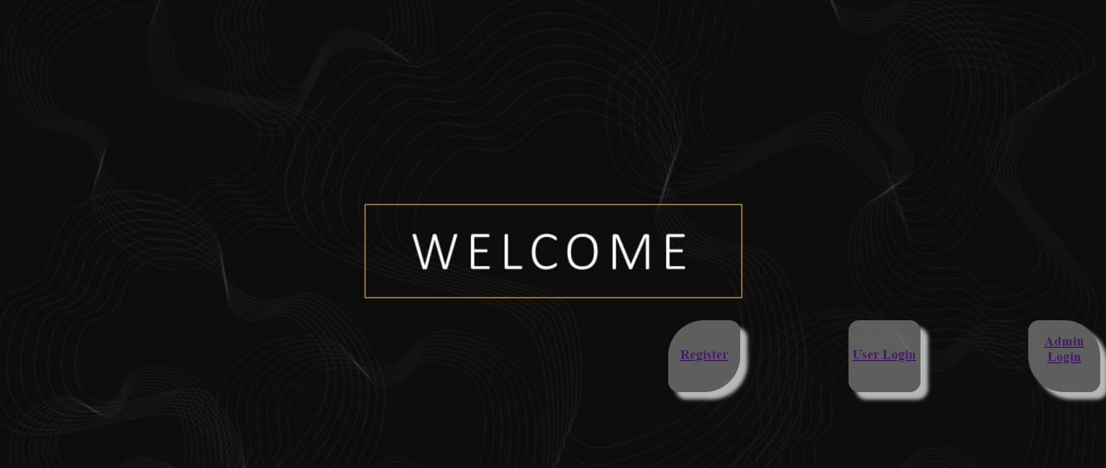
PROJECT INTERFACE

Slide 13
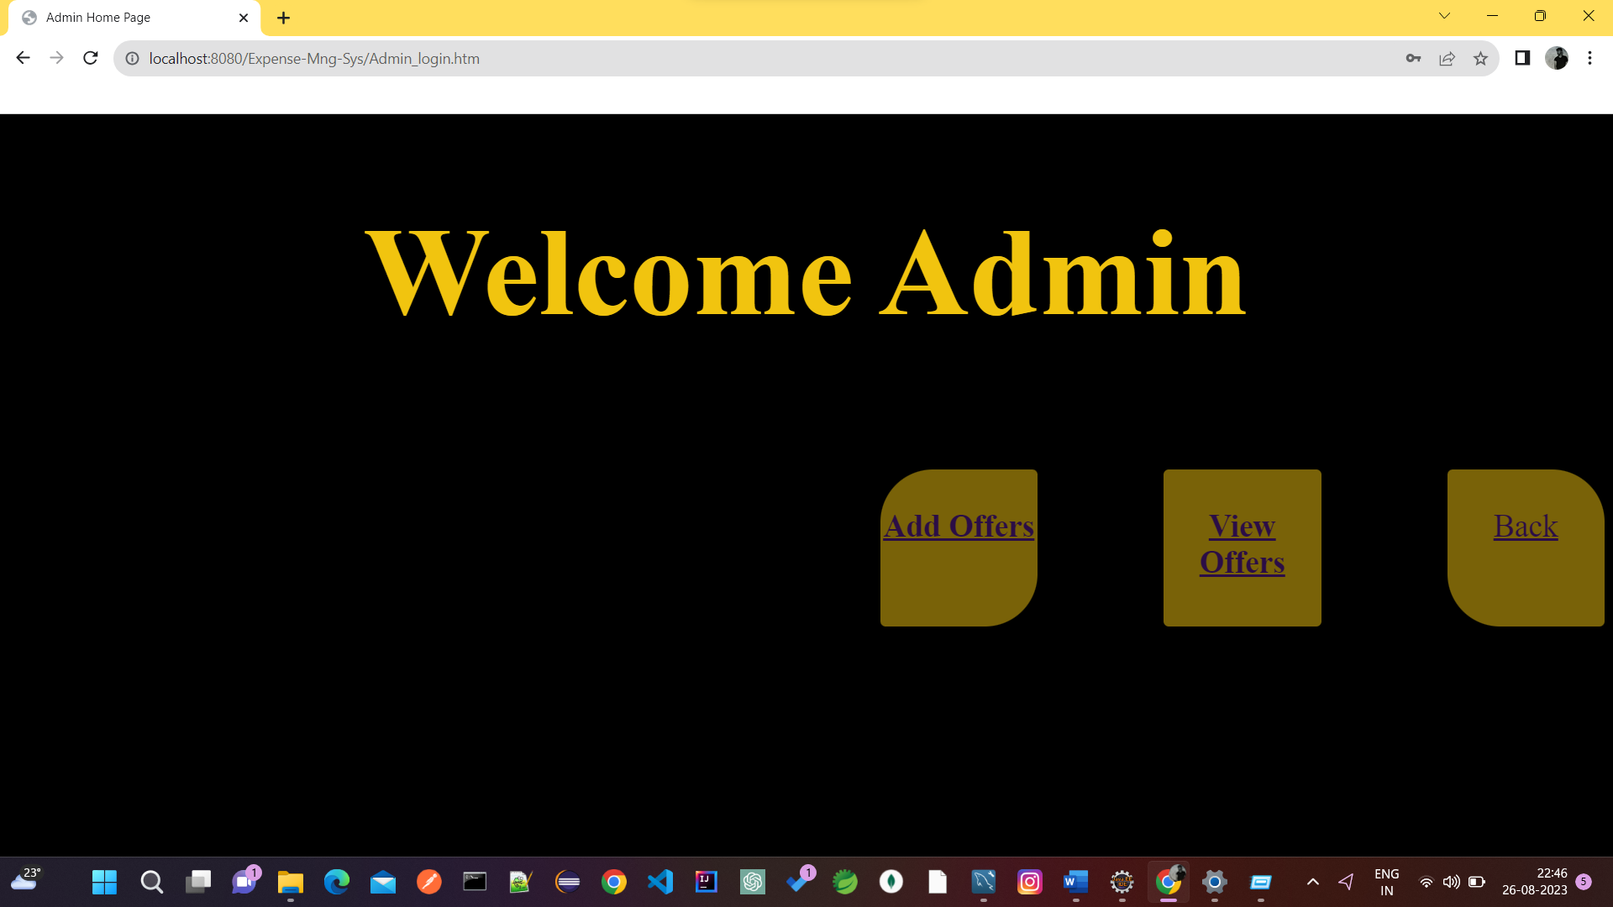

Slide 14
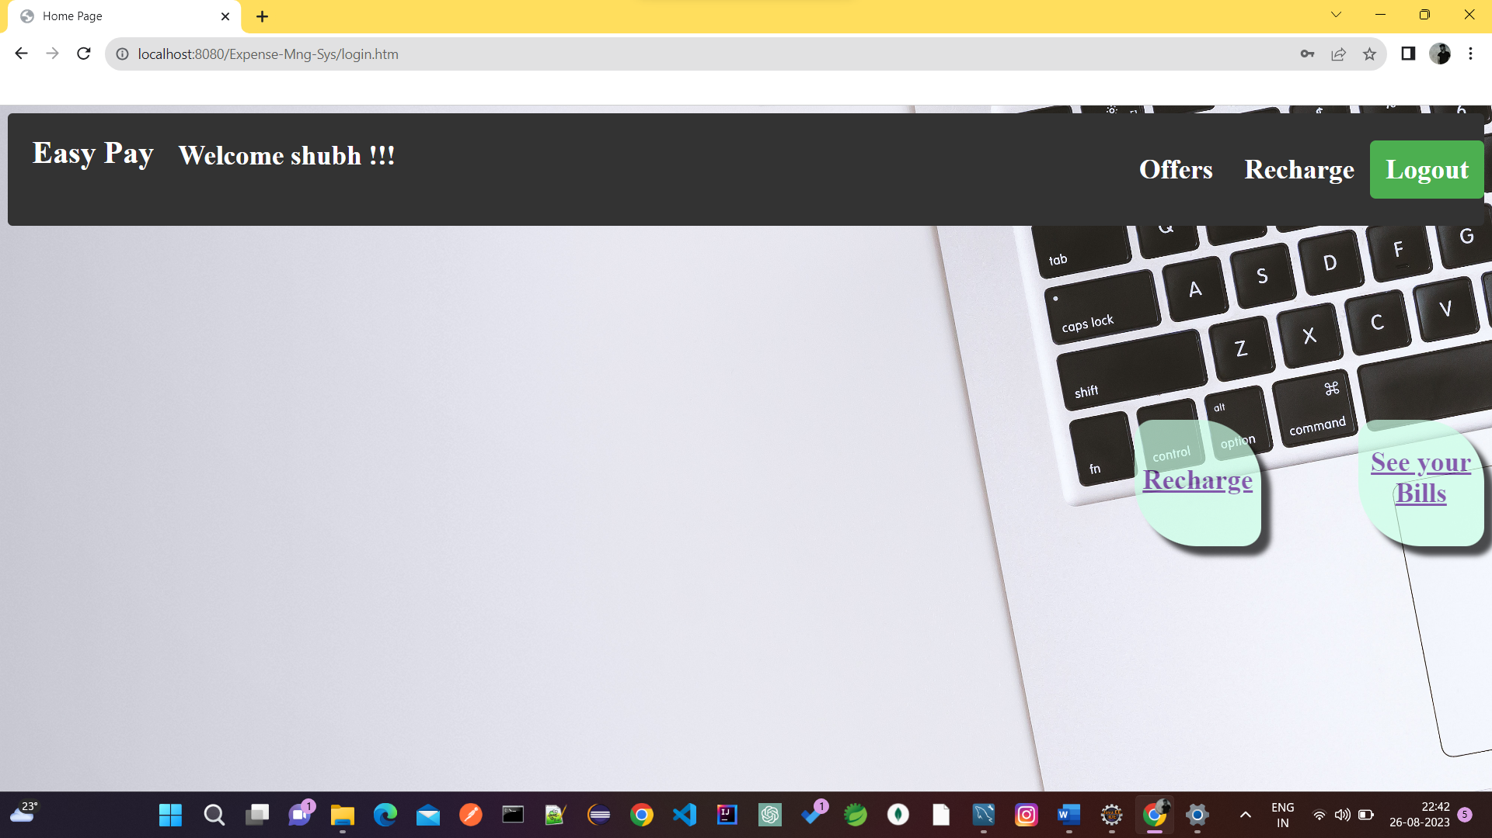

Slide 15
Stages at which Co-ordination was Needed
Requirement Specification
Database Design
Designing of UI and Connecting it to the backend.

Slide 16
Future Extension
Using whatever we have learnt over the duration of this course, we tried to make our project as user-friendly and gave it as many features as possible in the limited time allotted for the project work. That said, there are certainly more features that can be added to our application. Some of those are mentioned below:
The most recharged plan can be highlighted as users favorites.
Rating chart for Users will be provided to get feedbacks.
Discounts Vouchers can be given on a per-user basis depending on the users purchase history.

Slide 17
Future Extension
Users can upvote/downvote/report feedbacks.
Alert’s / pop up’s will be added for successful validation.
CAPTCHA can be added to login page.

Slide 18
Conclusion
In conclusion, the mobile recharge app project has achieved its goal of providing users with a user-friendly and secure platform for managing their mobile recharges. The app's intuitive interface and robust security measures ensure a seamless and safe transaction experience.
By offering customizable plans, transaction history tracking, and notifications, the app goes beyond basic recharges. Despite challenges, the project successfully leveraged technology to simplify digital transactions and contribute to the ongoing digital economy trend.
The collaborative efforts of the development team and the adoption of modern tools have culminated in a practical and efficient solution that meets user needs and expectations.

Slide 19
Thank You
SHREYAS VISHWAS KAMBLE 230360820049
SHUBHAM RANGNATH WAGHCHOURE
230360820052

